Slide 1
AUM-AR
Navigate Life, Not Just the Campus

Slide 2

Attention
GPA isn't the only thing that gets lost on campus.
Student life feels more like a survival challenge.
Many students feel disoriented or overwhelmed.
Draining:
Energy
Productivity
Mental Clarity
Busy schedules lack a smart tool.
This Photo by Unknown Author is licensed under CC BY-SA-NC

Slide 3
Need
University students manage packed schedules and complex campuses.
Outdated tools for modern problems.
Google Maps and calendar apps have limitations.
Impact on academic performance, time management, and mental health.

Slide 4
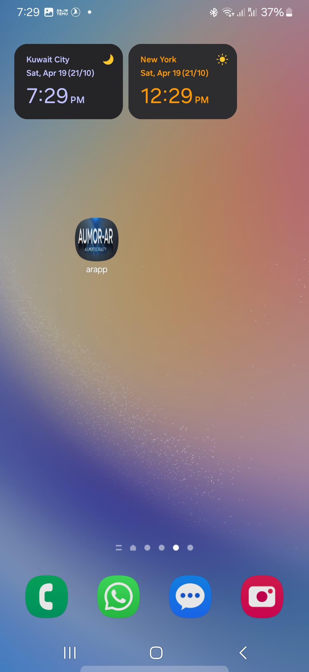

Solution
Introducing AUMAR.
Personalized campus companion.
Uses Augmented Reality for navigation.
Shows important locations and detailed pieces of information.

Slide 5
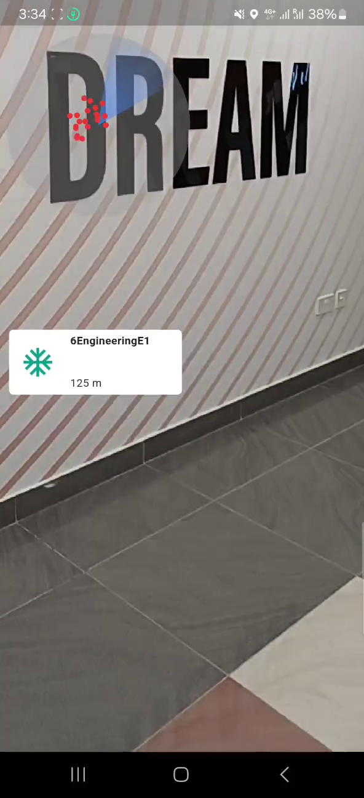
Features
Radar shows labs, classrooms, study zones, cafés, and library rooms.

Slide 6
Features
Radar shows labs, classrooms, study zones, cafés, and library rooms.
Floating labels will give the name of the location and the distance to it.

Slide 7
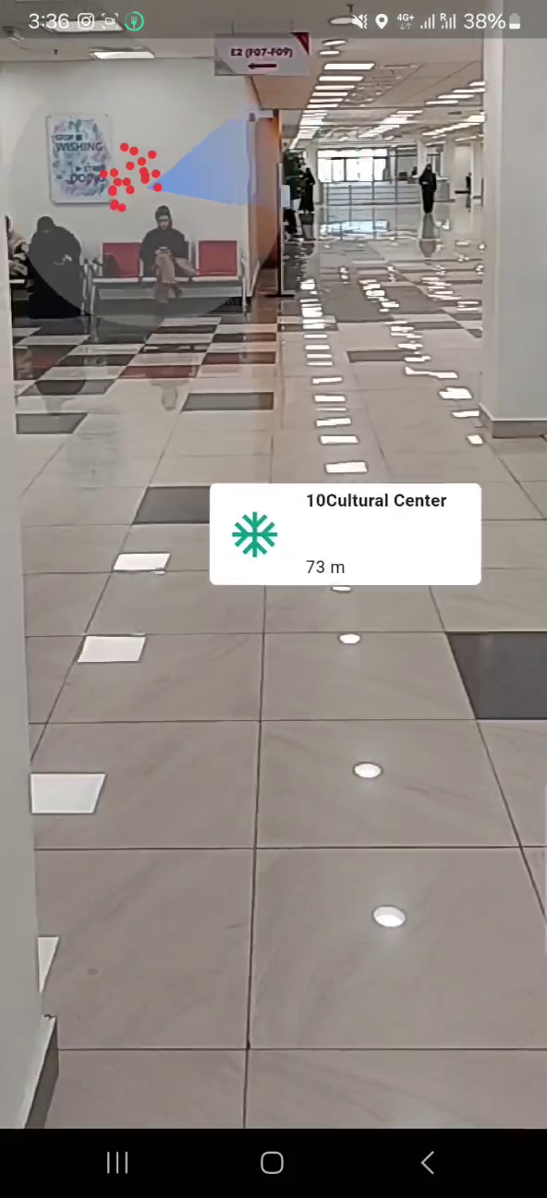
Features
Radar shows labs, classrooms, study zones, cafés, and library rooms.
Floating labels will give the name of the location and the distance to it.

Slide 8
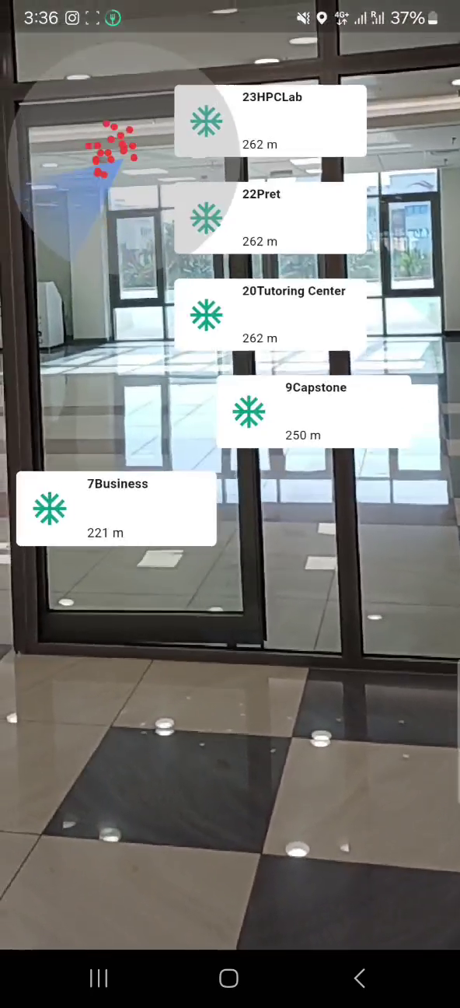
Features
Radar shows labs, classrooms, study zones, cafés, and library rooms.
Floating labels will give the name of the location and the distance to it.

Slide 9
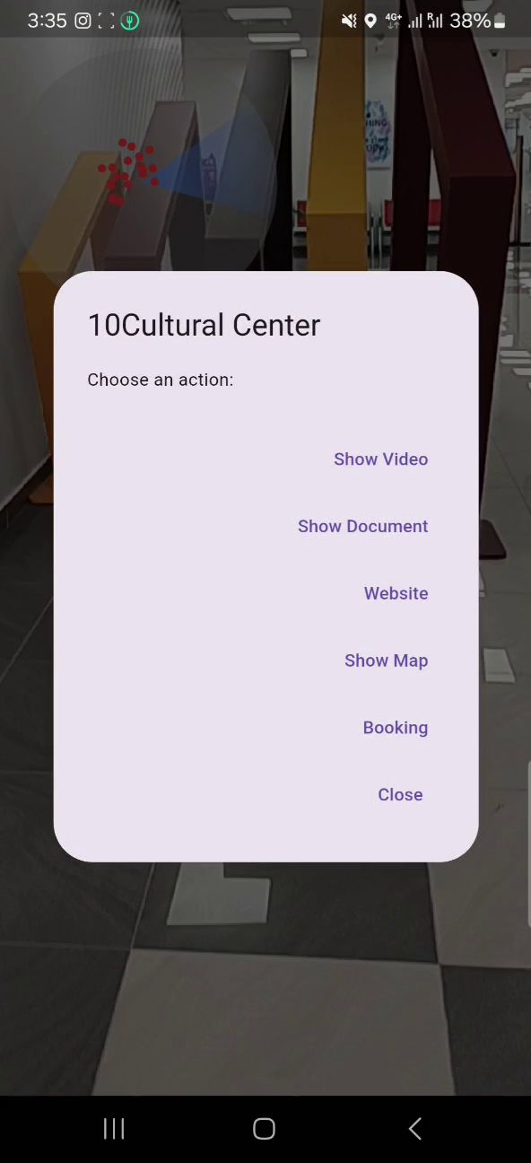
Features
Radar shows labs, classrooms, study zones, cafés, and library rooms.
Floating labels will give the name of the location and the distance to it.
Provides videos, documents, website links, and room maps.

Slide 10
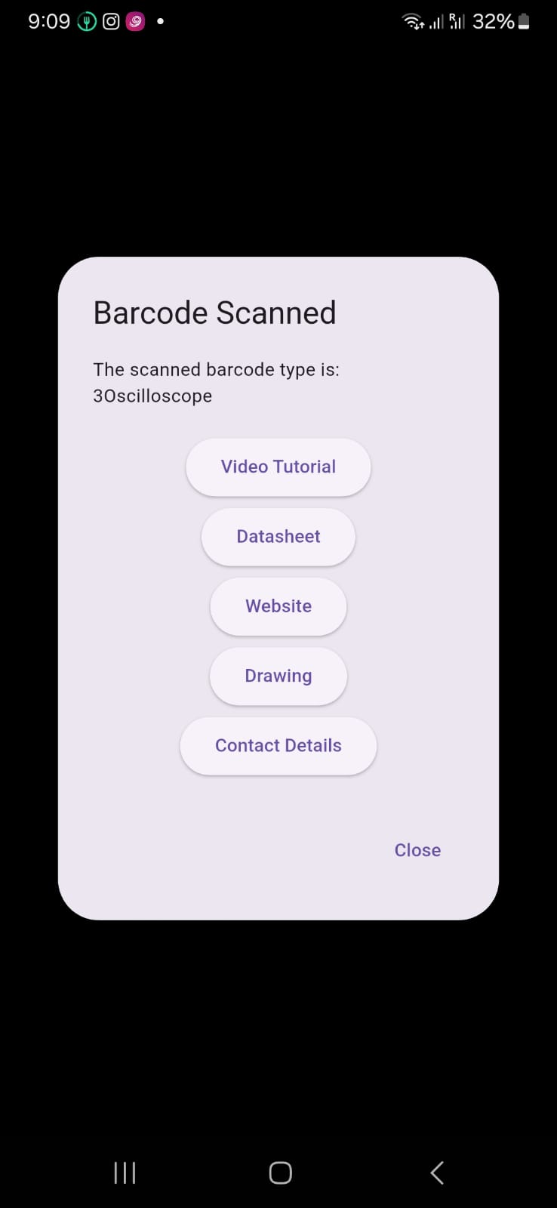
Features
Radar shows labs, classrooms, study zones, cafés, and library rooms.
Floating labels will give the name of the location and the distance to it.
Provides videos, documents, website links, and room maps.
Scans QR codes for detailed information.

Slide 11
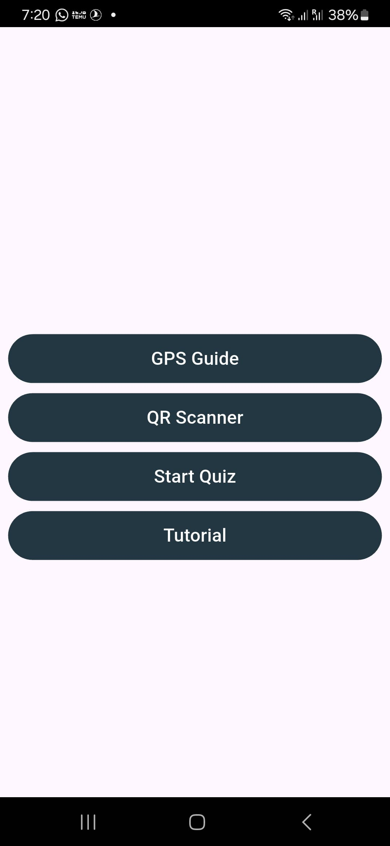
Features
Radar shows labs, classrooms, study zones, cafés, and library rooms.
Floating labels will give the name of the location and the distance to it.
Provides videos, documents, website links, and room maps.
Scans QR codes for detailed information.
Fun quiz for location familiarity.

Slide 12
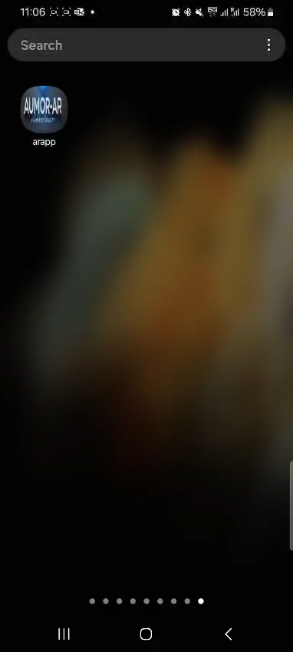
See the app in action: Video

Slide 13


Visualization
Version 1: Without AUMAR.
Running late, guessing routes, flustered, missed opportunities.
Chaotic, inefficient, mentally draining.
Version 2: With AUMAR.
Heads-up for class location, quiet study table suggestion.
Open study areas, room booking link.
Better day, AUMAR experience.
This Photo by Unknown Author is licensed under CC BY

Slide 14

Action
Choose the smarter path.
Choose AUM-AR
Join beta program for Android users.
Early access to premium features.
Voice in developing future updates.
This Photo by Unknown Author is licensed under CC BY-SA-NC

